Slide 1
DAT602 Proposal
Smart Food Storage – Chris Smith, Rupert Hawkins, Yuzhou Yao

Slide 2
OverView - Smart Food Storage
Food inventory shown on mobile (for refrigerated and cupboard stored food) by scanning groceries in and out.
Shows Product data – E.g. sell by date, calories, protein, fat etc.
Suggests recipes based on chosen ingredients and health factors.
Prompts you to use food that is approaching sell by date.

Slide 3
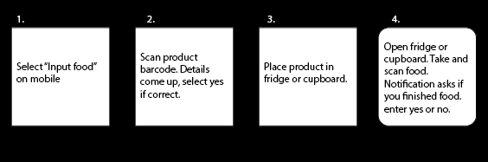
Process – How does it work?

Slide 4
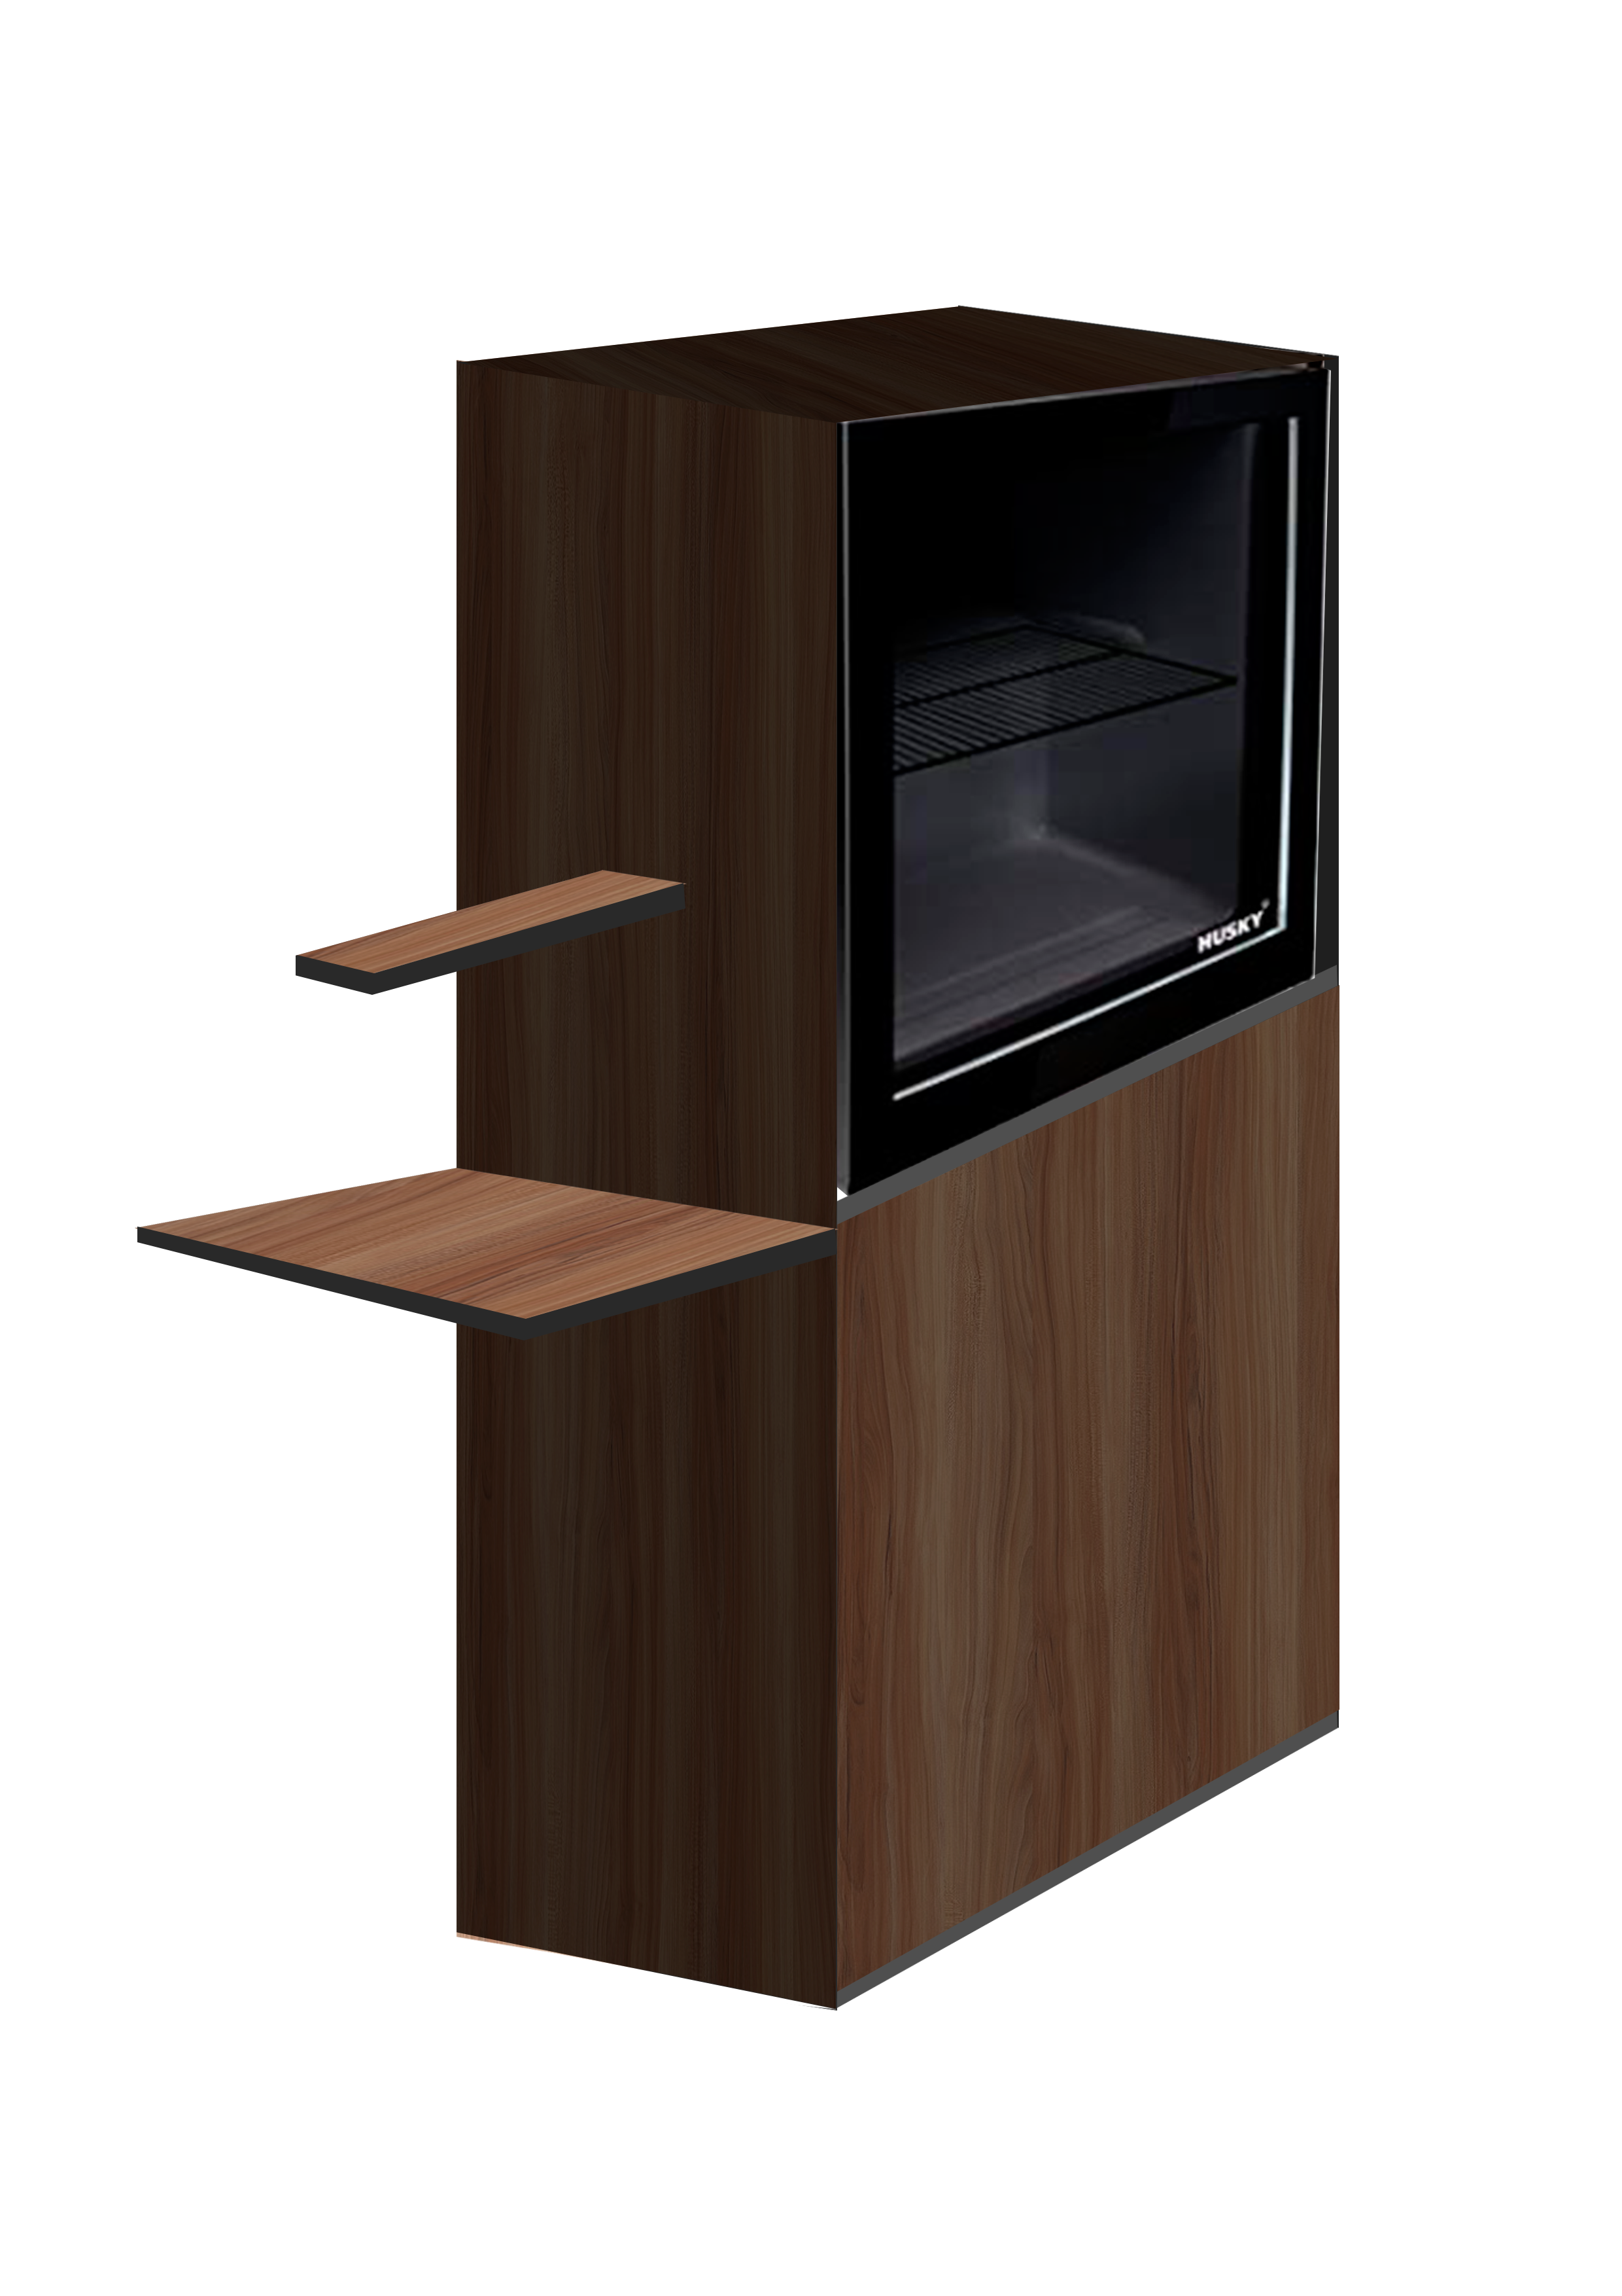
What will it look like?

Slide 5
Methodology – How will we make it?
Raspberry Pi
Webcam/Barcode scanner
Tesco Labs API
Edaman Recipe API
Phonegap
RFID tag

Slide 6
Context + Inspiration – Whats the point?
To consider everyday domestic objects and how they can better our lives
To consider humans daily consumption, how can we reduce it to better our lives
Aims to reduce food wastage through prompting the use of food close to sell by date
Aims to save money for the consumer
Aims to better our lives through making our food situations easier and prompting healthy recipes

Slide 7
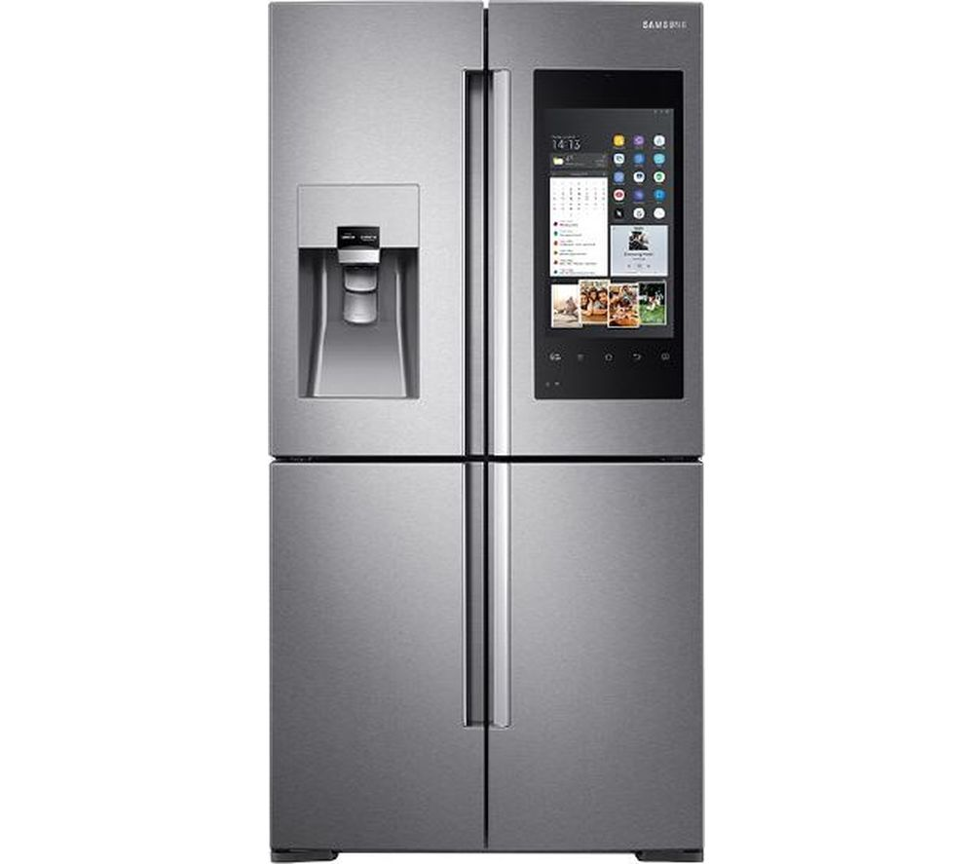
Inspiration – Samsung Family Hub
Samsung Fridge
View inside of fridge from your phone
Watch TV on the fridge
Listen to radio from the fridge
Our Fridge
Inventory/database of fridge contents
Nutritional Value of foods
Healthy recipe suggestions
Prompts you to use up food approaching best before date, preventing food wastage and saving money

